Slide 1
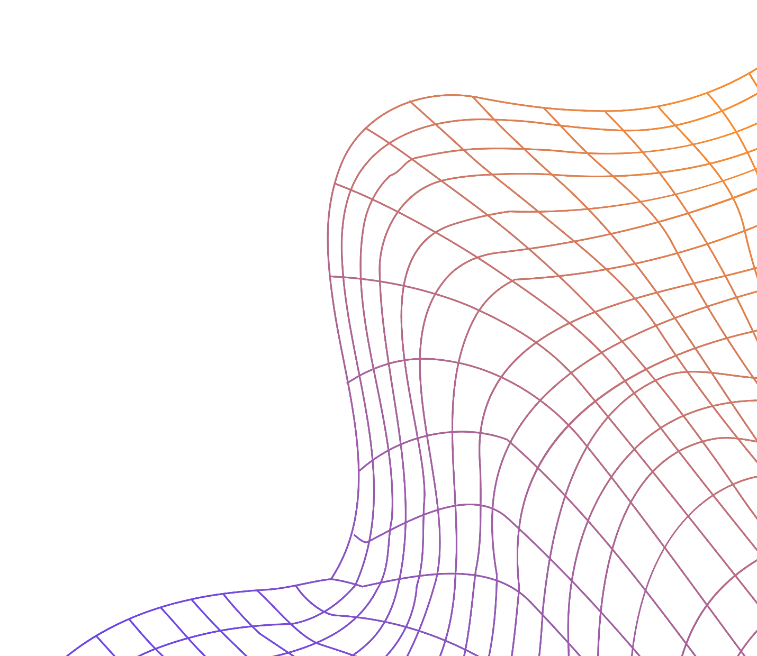
CNN Vegetable Image Classifier
Part A
Yadanar Aung
2214621
DAAA/FT/2B/07
ST1504 DELE

Slide 2
Table of contents
01.
02.
03.
04.
05.
06.
Data Understanding
Data Preprocessing
Modelling
Exploratory Data Analysis
Data Augmentation
Rescaling
Input sizes 128 x 128 & 31 x31
Model Improvement
Model Evaluation
Error Analysis
Regularizers
Optimizers
Confusion Matrix
Comparison

Slide 3
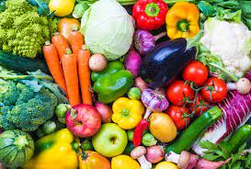
01
Background Understanding
Task: Implement image classifier to identify 15 different types of vegetables
Build 2 types of neural network for Grayscale 31x31 pixels & 128x128 pixels
Visually, vegetables are distinguishable by colour & shape
Distinct vegetable colour groups:
Red
Orange/Yellow
White/Brown
Green
Blue/Purple
However, now that the vegetables are grayscale, it is much harder to identify & differentiate
This is the challenge for us to tackle

Slide 4
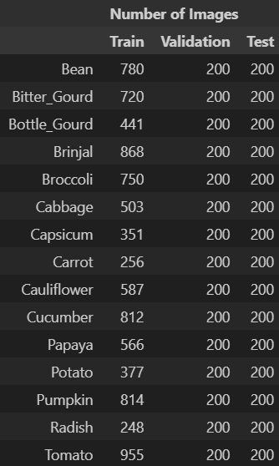
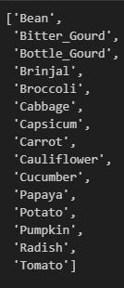
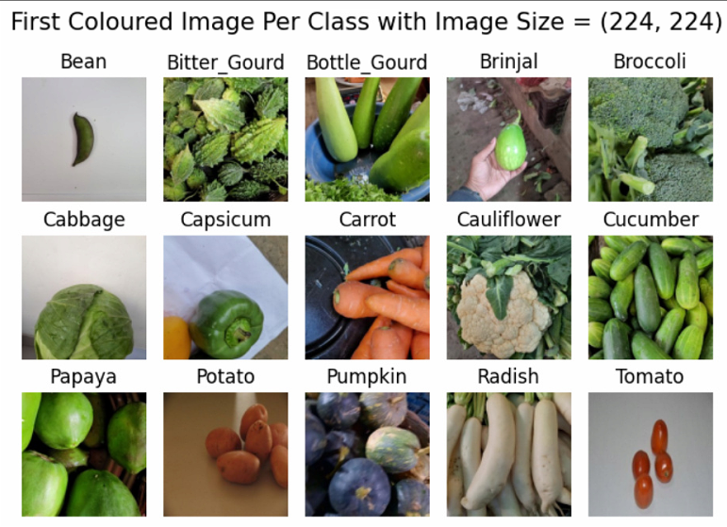
01
Data Understanding
3 Vegetable Datasets: Train, Validation & Test
Total of 15,028 Coloured Images of size 224 x 224 pixels
15 Vegetable Classes:

Slide 5
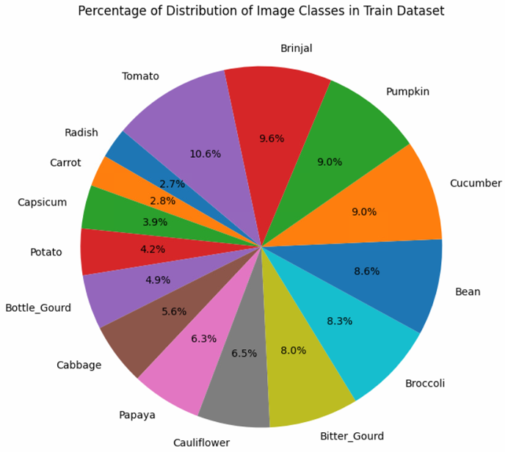
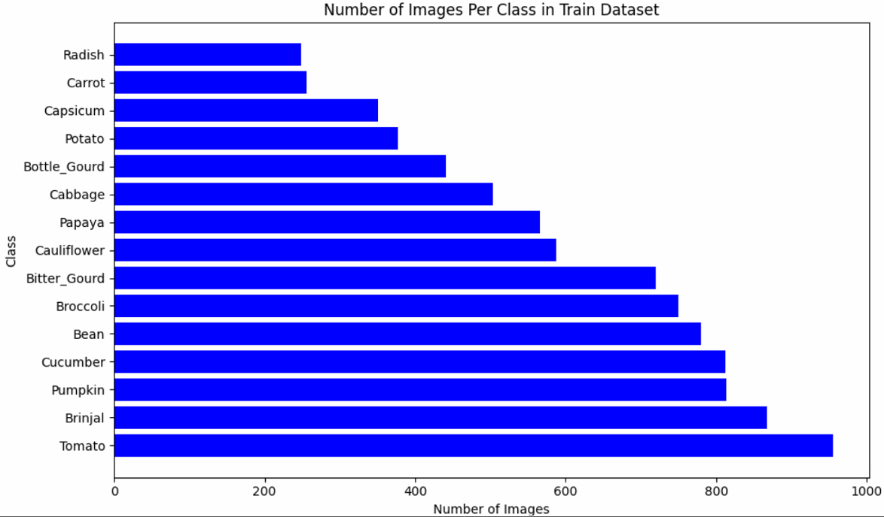
01
Exploratory Data Analysis
Imbalanced Class Distribution in Train Dataset
May cause overfitting

Slide 6
01
Exploratory Data Analysis: Original Dataset
Common shapes:
Round, Circular, Oval, Long, Short
With the colour, it is easy to identify the vegetables

Slide 7
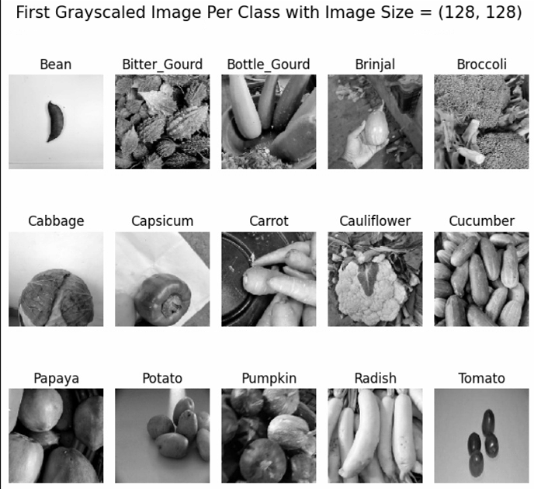
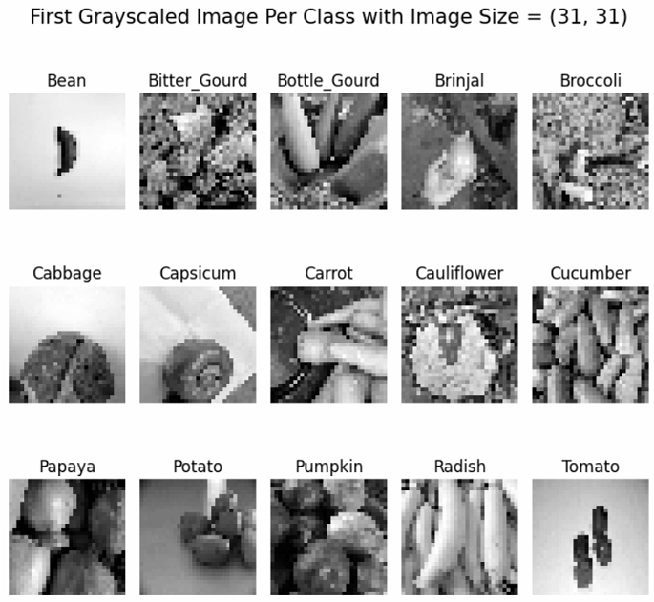
01
Exploratory Data Analysis: Grayscale
Colour information is lost
As most of the vegetables have a common shape, this might cause confusion
Leads to ambiguity, as an image of a vegetable can be open to more than one interpretation

Slide 8
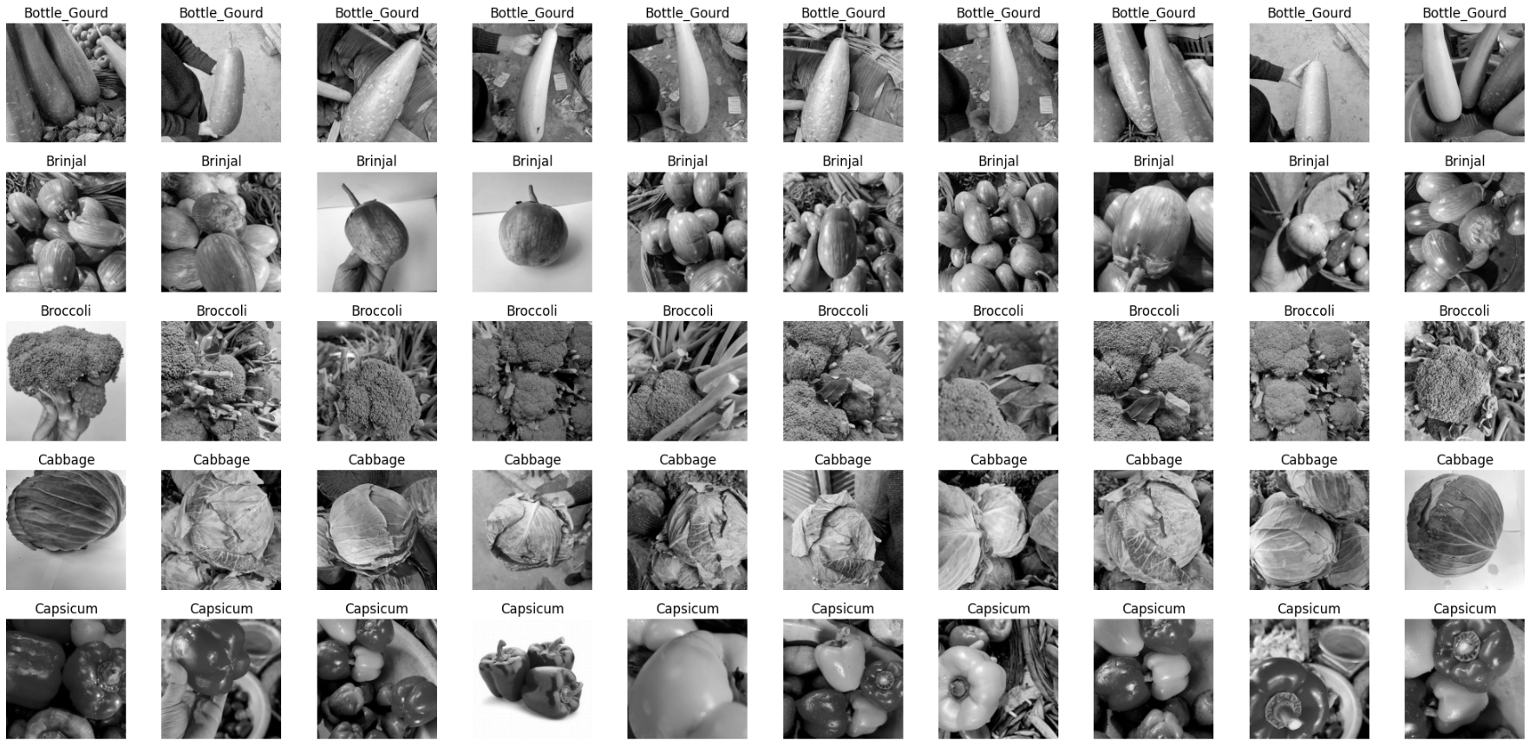
01
Exploratory Data Analysis
Orientation not consistent
Absence / Presence of Hands
Qty & Size of Vegetable varies
Background of Vegetable varies
Dataset is not clean & is noisy
Based on random selection, no clear indication of wrongly classified vegetables

Slide 9
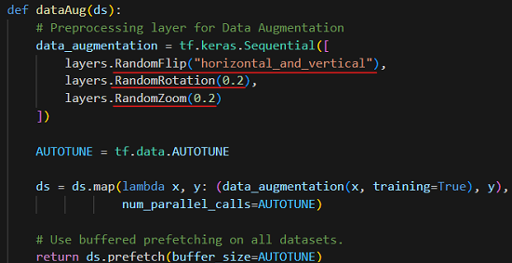
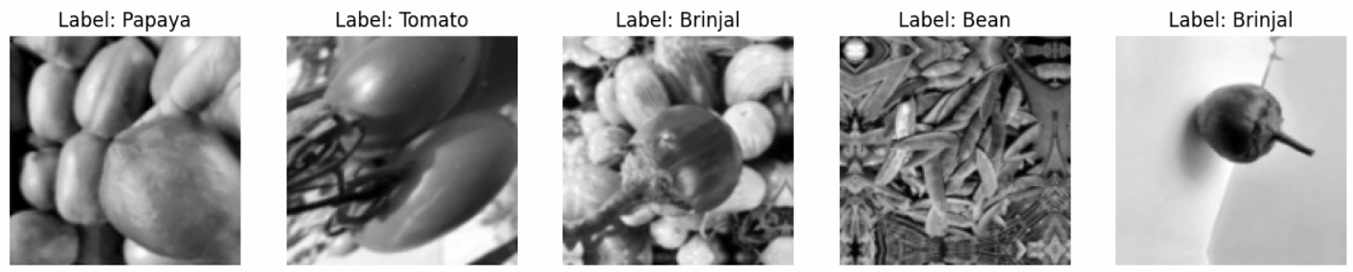
02
Data Pre-Processing: Data Augmentation
Generate additional training data on all vegetables
Using Random Transformations
Total Images Combined: 18,112
Prevent Overfitting
Its effects to be investigated later on

Slide 10
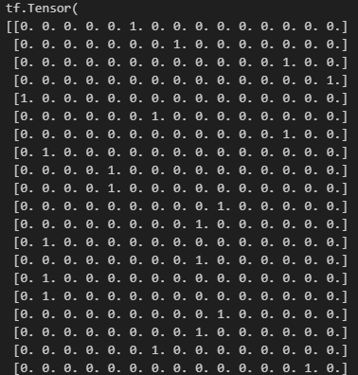
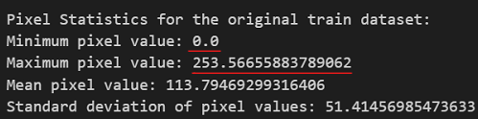
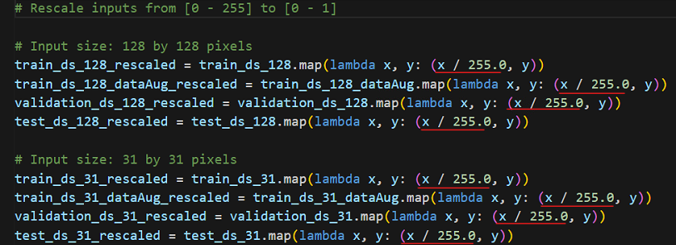
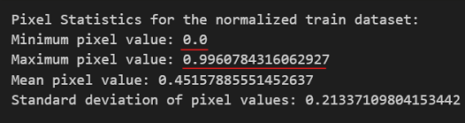
02
Data Pre-Processing
One-Hot Encoding
2. Rescaling from [0,255] to [0,1]
Before:
After:

Slide 11
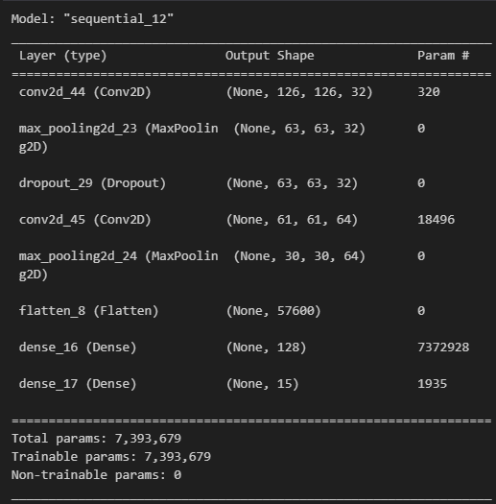
03
Modelling: Baseline Model
Baseline CNN Model for both input sizes:
31 x 31
128 x 128
Aim: Investigate if data augmentation will be beneficial to performance of our models
Afterwards, build respective complex model for each input size

Slide 12
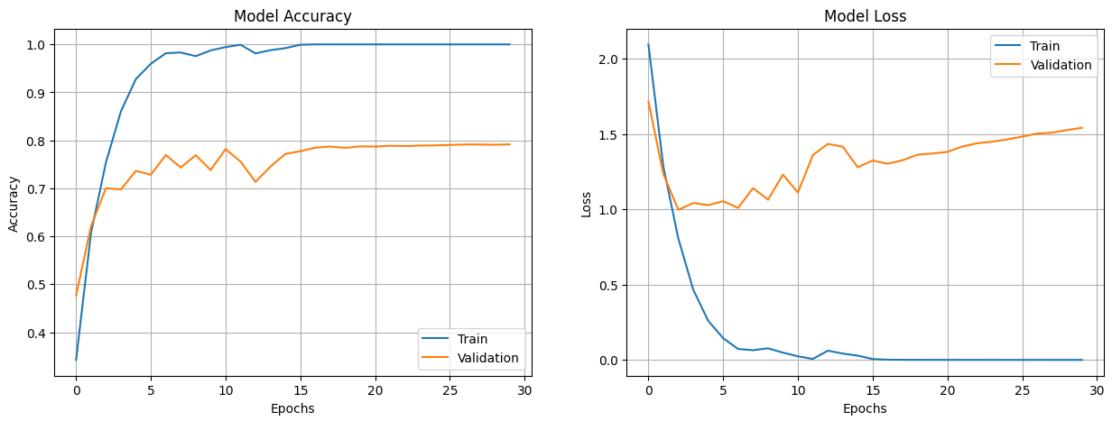
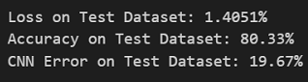
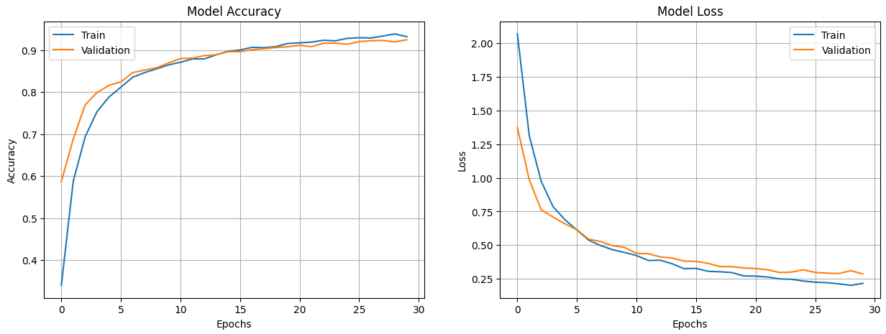
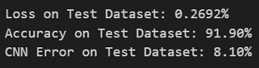
03
Modelling: Baseline 128x128 Model
Without Data Augmentation
Strong Overfitting
2. With Data Augmentation
Little to no Overfitting
Test Accuracy Improved
Proven to be Beneficial

Slide 13
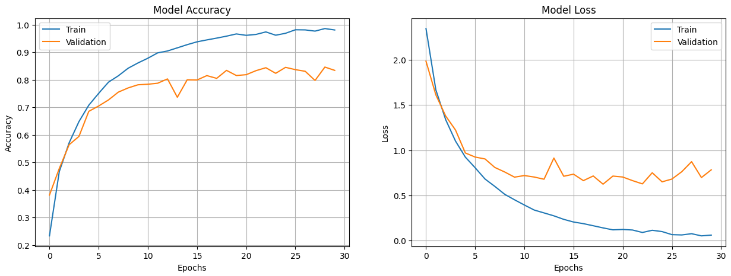
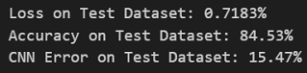
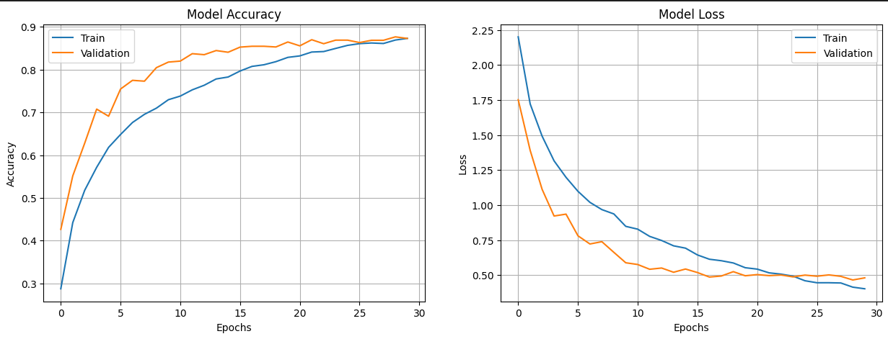
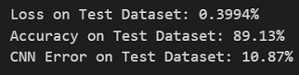
03
Modelling: Baseline 31x31 Model
Without Data Augmentation
Strong Overfitting
2. With Data Augmentation
Little to no Overfitting, instead there is underfitting
Test Accuracy Improved
Proven to be Beneficial

Slide 14
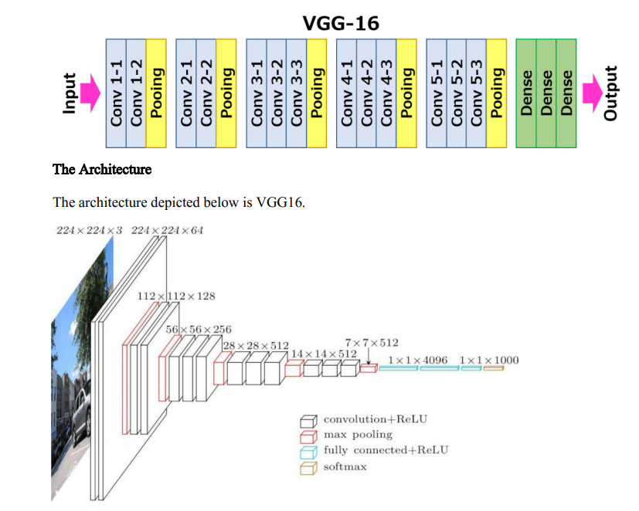
03
Modelling: Complex Models
Inspiration from VGG-16
One of the best computer vision models to date
Simplify the architecture to suit my resources & dataset
Notes:
Simplify by removing some Conv2D layers

Slide 15
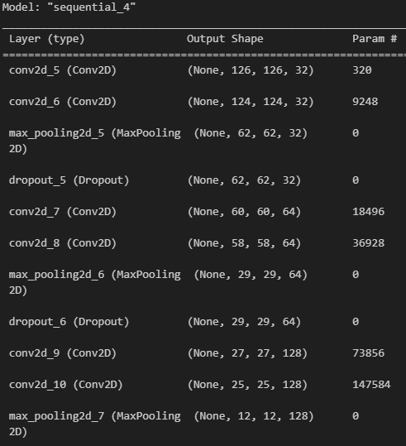
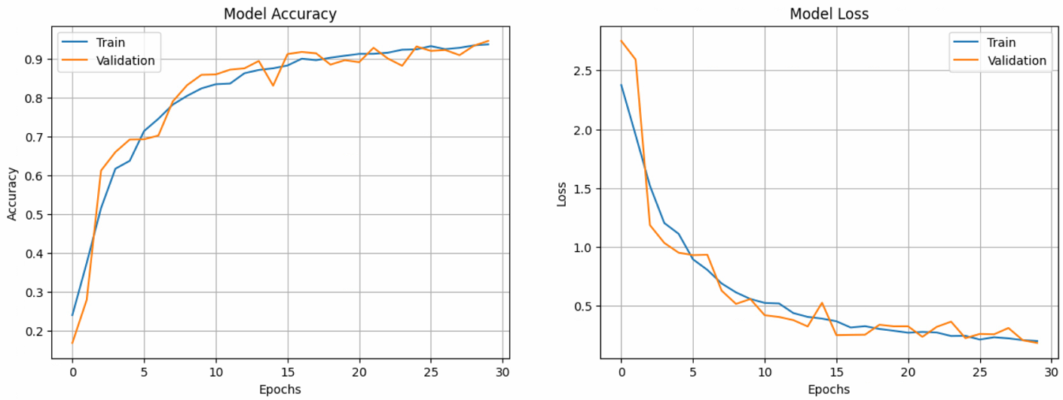
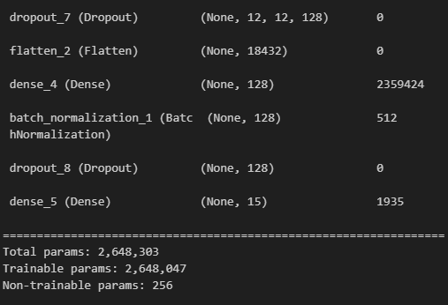
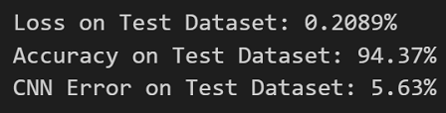
03
Selected 128x128 Model
Increased Dropout Size from 0.2 to 0.4: Reduce Overfitting
Double Conv2D layers: Stable Model
Batch Normalization Layer

Slide 16
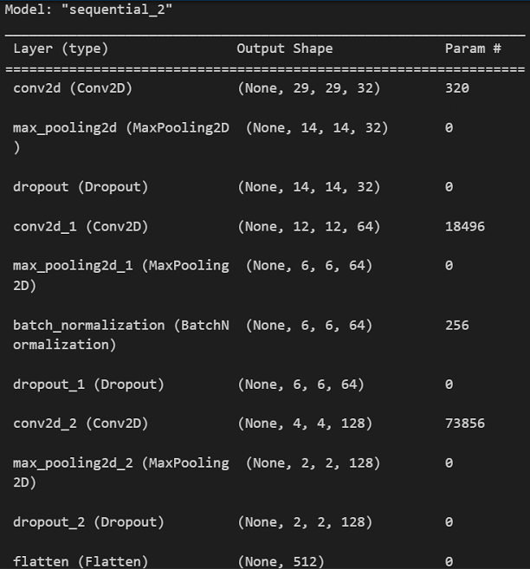
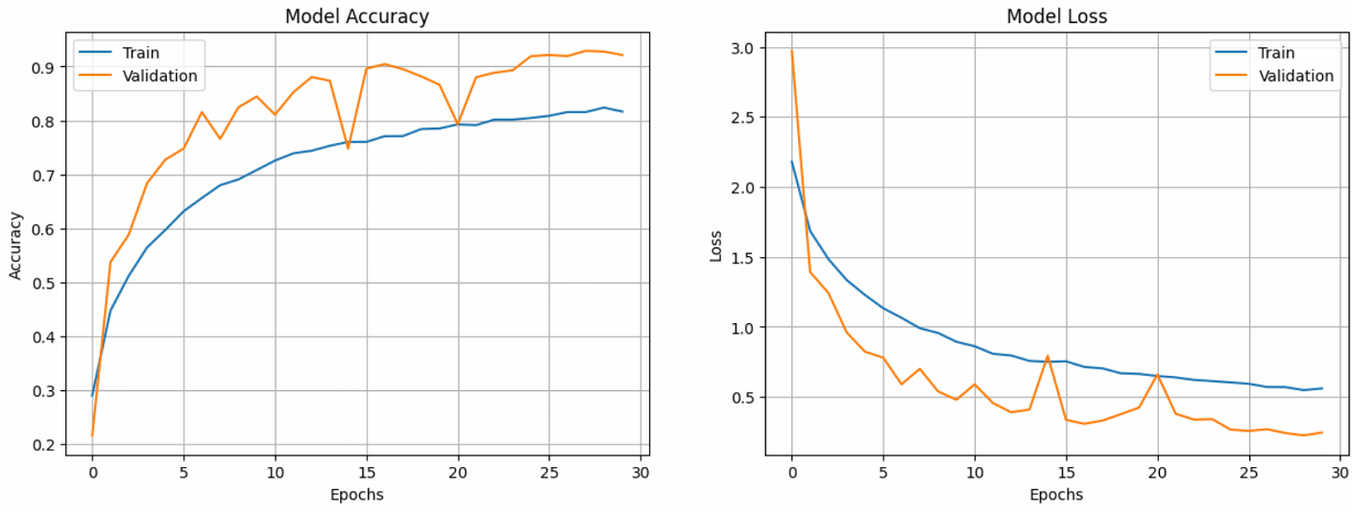
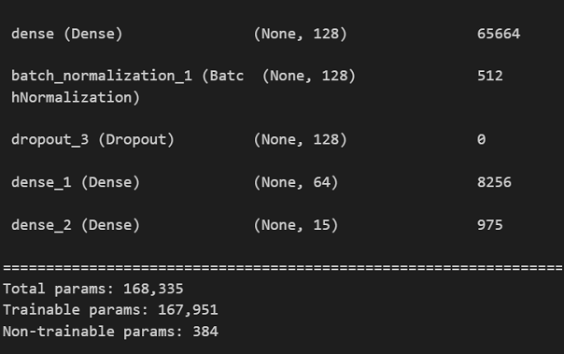
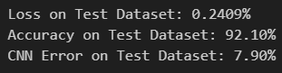
03
Selected 31x31 Model
Increased Dropout Size from 0.2 to 0.3: Reduce Overfitting
Batch Normalization Layer
Notes:
Despite the test accuracy increasing, the Model is under fitted as we can see from the training dataset performing poorly as compared to the validation dataset. This is due to the simple architecture used, resulting in the model being unable to capture the relationship between the input features and the output classes. Moreover, I have also included multiple dropout layers. When training, a percentage of the features are set to zero (50% in your case since you are using Dropout(0.5)). When testing, all features are used (and are scaled appropriately). So the model at test time is more robust - and can lead to higher testing accuracies.
This may be also due to high bias and low variance, as we have a class imbalance

Slide 17
04
Model Improvement
Layer Kernel Regularizers:
Penalize weights which are large, might be causing model to overfit
L1 Regularization Penalty: loss = l1 * reduce_sum(abs(x))
L2 Regularization Penalty: loss = l2 * reduce_sum(square(x))
Optimizers:
Adam (Adaptive Moment Estimation)
Adapts learning rates for each parameter based on their historical gradients
SGD (Stochastic Gradient Descent)
Updates the model parameters in the opposite direction of the gradient of the loss with respect to the parameters
RMSprop (Root Mean Square Propagation)
Adjusts learning rates for each parameter individually based on the magnitude of the gradients, allowing for faster convergence

Slide 18
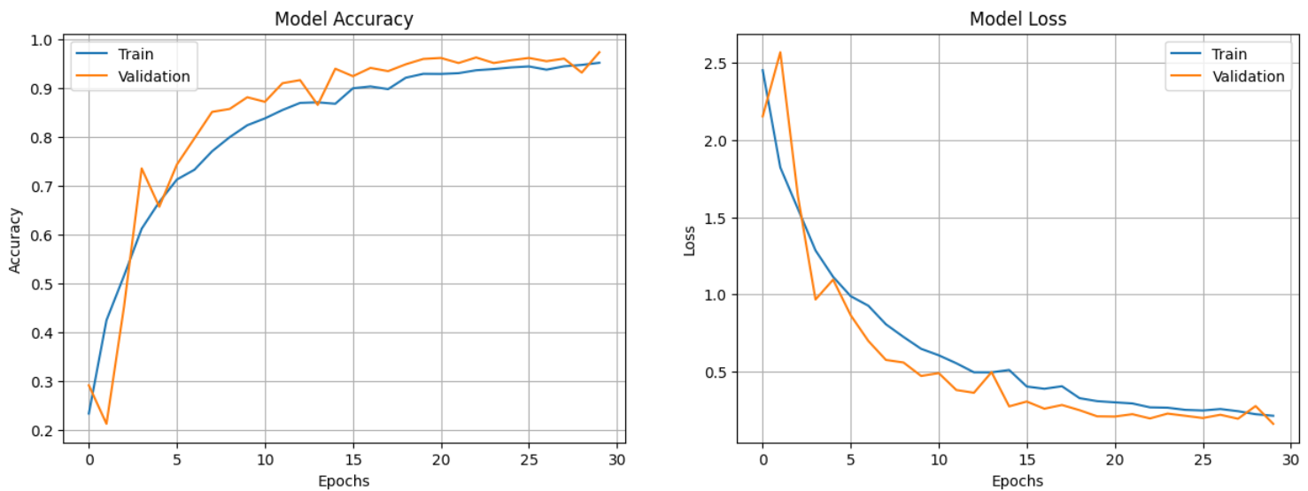
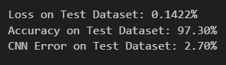
05
Final 128x128 model
Layer Kernel Regularizers:
L2
Optimizers:
Adam

Slide 19
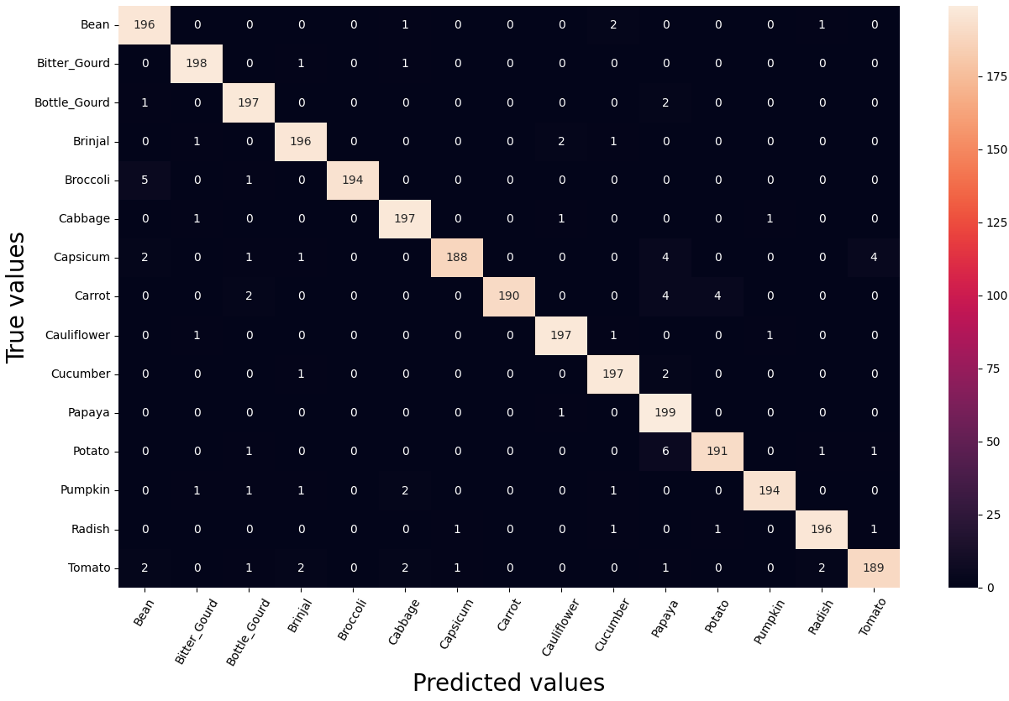
05
128x128 Model Evaluation
Most Labels Getting Mixed Up
Capsicum:
12 wrongly classified as Tomato, Papaya, Bean, Brinjal, Bottle_Groud
Tomato:
11 wrongly classified as Radish, Potato, Cabbage, Bean, Brinjal
Otherwise, the model is able to predict most labels accurately with less than 10 samples wrongly classified

Slide 20
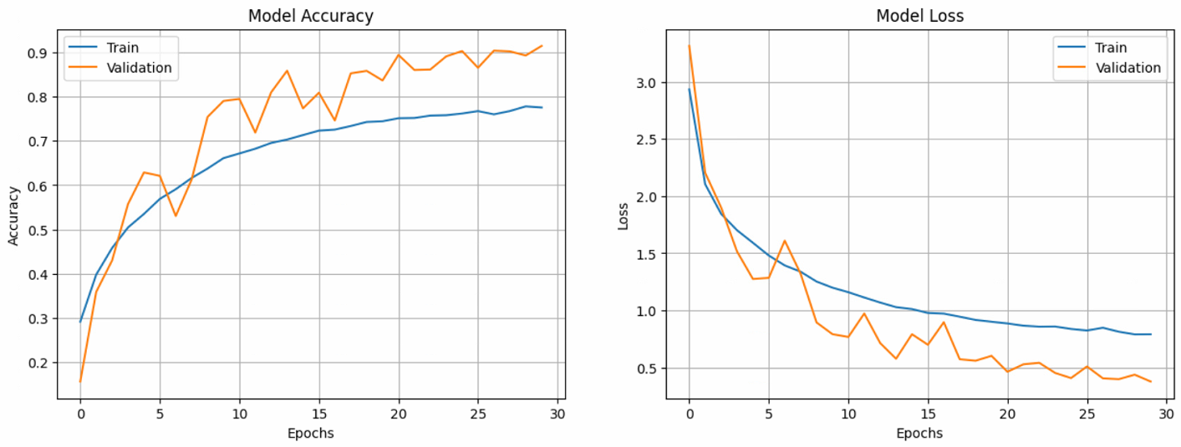
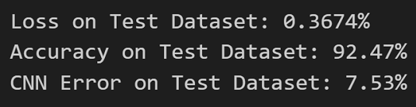
05
Final 31x31 model
Layer Kernel Regularizers:
L1
Optimizers:
Adam
However, there are signs of underfitting.
Possibility due to the simple model architecture.
It is also noted that the model takes longer to train.

Slide 21
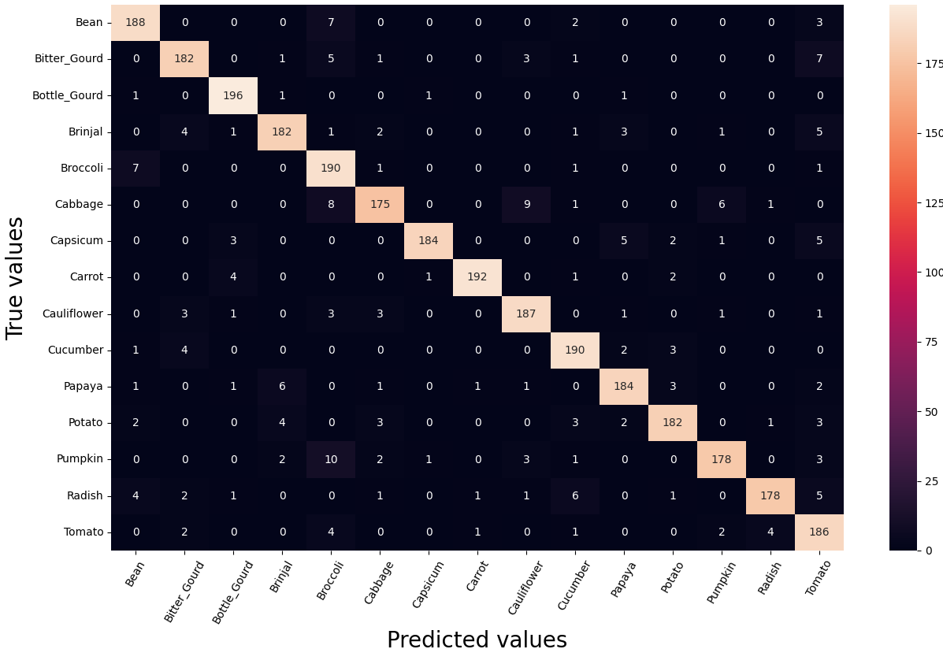
05
31x31 Model Evaluation
Most Labels Getting Mixed Up
Cabbage:
25 wrongly classified as Cauliflower, Pumpkin, Broccoli
Radish:
11 wrongly classified as Radish, Potato, Cabbage, Bean, Brinjal
Otherwise, the model is able to predict most labels accurately
Compared to 128x128, 31x31 has more errors in identifying the labels

Slide 22
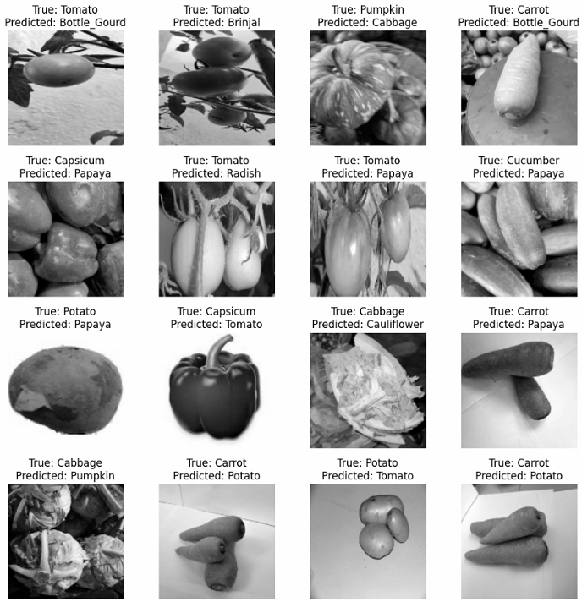
06
Error Analysis: 128x128
The model gets confused between Capsicum/Tomato due to their similar circular shape and Carrot/Potato/Papaya due to similar oval shape
The model fails to correctly classify the vegetable as the test images are stretched or taken from an awkward angle as seen in the tomato images
Notes:
Compare & discuss the classification accuracies for each input size.

Slide 23
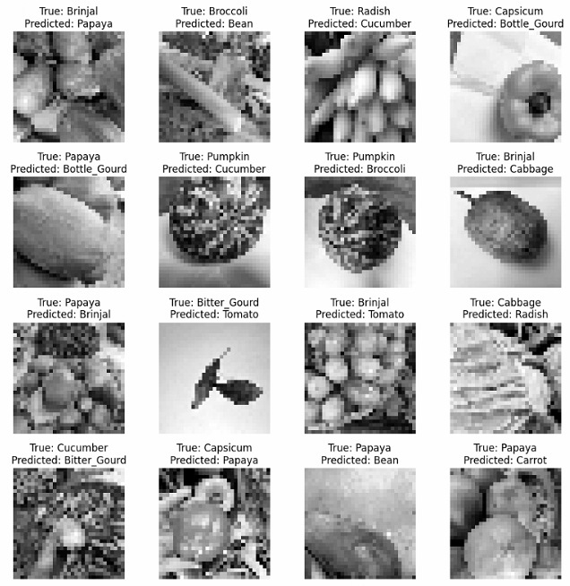
06
Error Analysis: 31x31
Similarly, the model gets confused between vegetables such as Brinjal/Tomato due to their similar circular shape
However, there are instances whereby the vegetables have different shapes but the model still wrongly classifies it
Bitter Gourd has an oval shape while Tomato has a circular shape
At 31 x 31 pixels, the shapes are harder to be captured by the model.

